Slide 1
Avalauncher

Slide 4
Helicopter Blasting

Slide 6
Video
Notes:
Do video here………

Slide 7
Hwy 12
Lochsa River

Slide 9
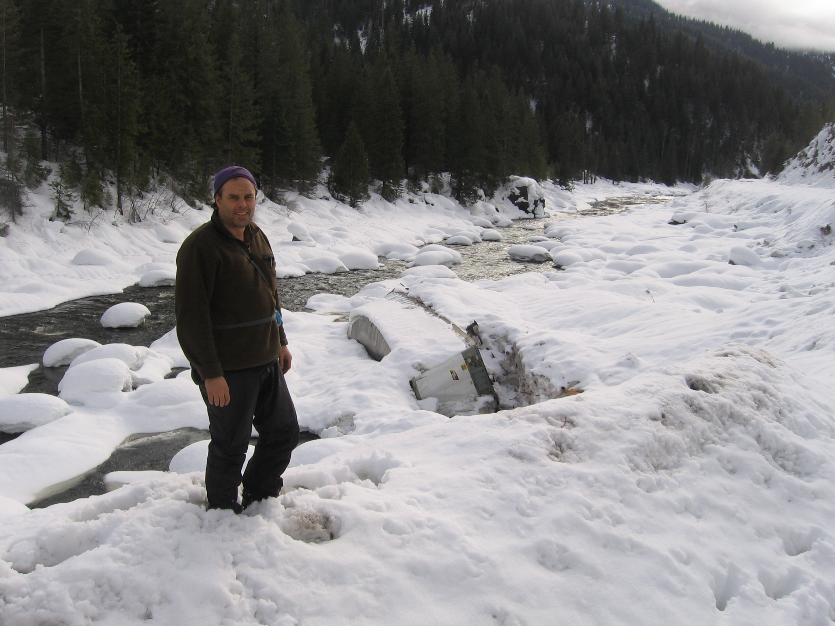

Slide 11
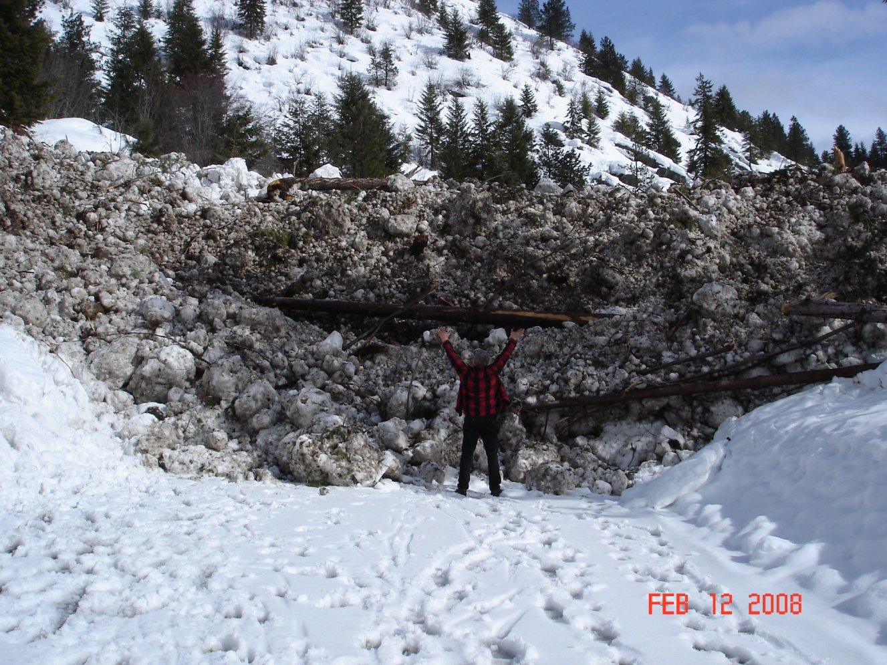

Slide 13
